Slide 1


LAND SALES ANALYSIS
USING
RATIO’S
BY
RICK O. BAUMGARDNER, MAI, SRA, ASA

Slide 2



Land Valuation is needed for most Right of Way Appraisal Assignments.
There are several methods to determine Land Value.
RESEARCH
ABSTRACT
DESIGN

Slide 3
Most of the time we use a Sales Comparison Method to determine Land Value. But Allocation can also be used.
RESEARCH
ABSTRACT
DESIGN

Slide 4
LAND CAPABILITY CLASSIFICATION SYSTEM
Most widely accepted land capability classification system is the one developed by the United States Department of Agricultural Natural Resources Conservation Service (NRCS).

Slide 5
Land Capability Classes. Capability classes are designated by the roman numerals I through VIII. As the class numbers increase, greater limitations and a narrower choice of practical uses are indicated:

Slide 6
Class I soils have few limitations that restrict use.
Class II soils have moderate limitations, which reduce the choice of plants that can be grown or indicate the need for moderate conservation practices.
Class III soils have severe limitations, which reduce the choice of plants, indicate the need for special conservation practices, or both.
Class IV soils have very severe limitations, which restrict the choice of plants, indicate the need for very careful management, or both.
Class V soils generally are not considered suitable for cultivation. These soils are not likely to erode, but they have other limitations that are impractical to remove and limit their use.
Class VI soils have severe limitations that make them generally unsuited for cultivation.
Class VII soils have very severe limitations that make them unsuited for cultivation.
Class VIII soils and land forms have limitations that nearly preclude their use for commercial crop production.

Slide 7
These classes can be used for data analysis of a group of sales, or to allocate the sale price.

Slide 8
To demonstrate a method using land class ratings for comparison purposes.
For the purpose of the demonstration we will use 3 classes of land : Land Type 1, Land Type 2, and Land Type 3.

Slide 9
Allocation can be used for many areas of data analysis. Some of these are:
Allocation of a sale price between land and buildings.
Allocation of land contribution between various land types.
Allocation of building contribution between multiple building types.
Allocation of total accrued depreciation between various building types.
Allocation of building specific depreciation amongst various forms of depreciation.
Allocation of income amongst components of the unitary whole.
Allocation of expenses amongst components of the unitary whole.

Slide 10
For this segment today, we are going to focus on:
Allocation of land contribution between various land types.
RESEARCH
ABSTRACT
DESIGN

Slide 11
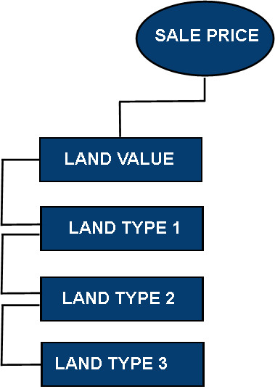
Sale Price Allocation Schematic
RESEARCH
ABSTRACT

Slide 12
USE OF PROPORTIONALITY
Price Allocation Ratios
(APR)

Slide 13
Proportionate land analysis, or price ratios, became a necessity when two or more land types were present within properties. The land within the whole became a key to understanding markets and value. Just as a blended price per acre of an improved property includes both the land and building contributions, two different components, so does a blended price per acre of a property with differing land types within its boundaries that are worth differing levels based on the market.

Slide 14
In many rural markets, the price of a particular type of land often times exceeds that of another, all else equal. As land size grows, the likelihood of a property boundary capturing more than one type of land within the boundaries increases. Valuers must have a basic understanding of the way these various mixtures impact the blended price per acre and the mathematical processes necessary to analyze such variations.

Slide 15
Value Ratios
Type 1 land consistently brings $3,000 per acre.
Type 2 land consistently brings $1,500 per acre.

Slide 16
Price relationships have historically utilized the highest priced land in a market as the basis and all inferior categories with lower selling prices are expressed as a percentage of the highest priced. Type 1 land is the highest and is assigned 100% price ratio, or essentially $1.00. Type 2 land sells for approximately half of that shown by Type 1; thus, it is assigned a 50% ratio. In terms of dollars, Type 2 land then equates to $0.50 per acre, and so on for all remaining inferior categories if they exist.

Slide 17
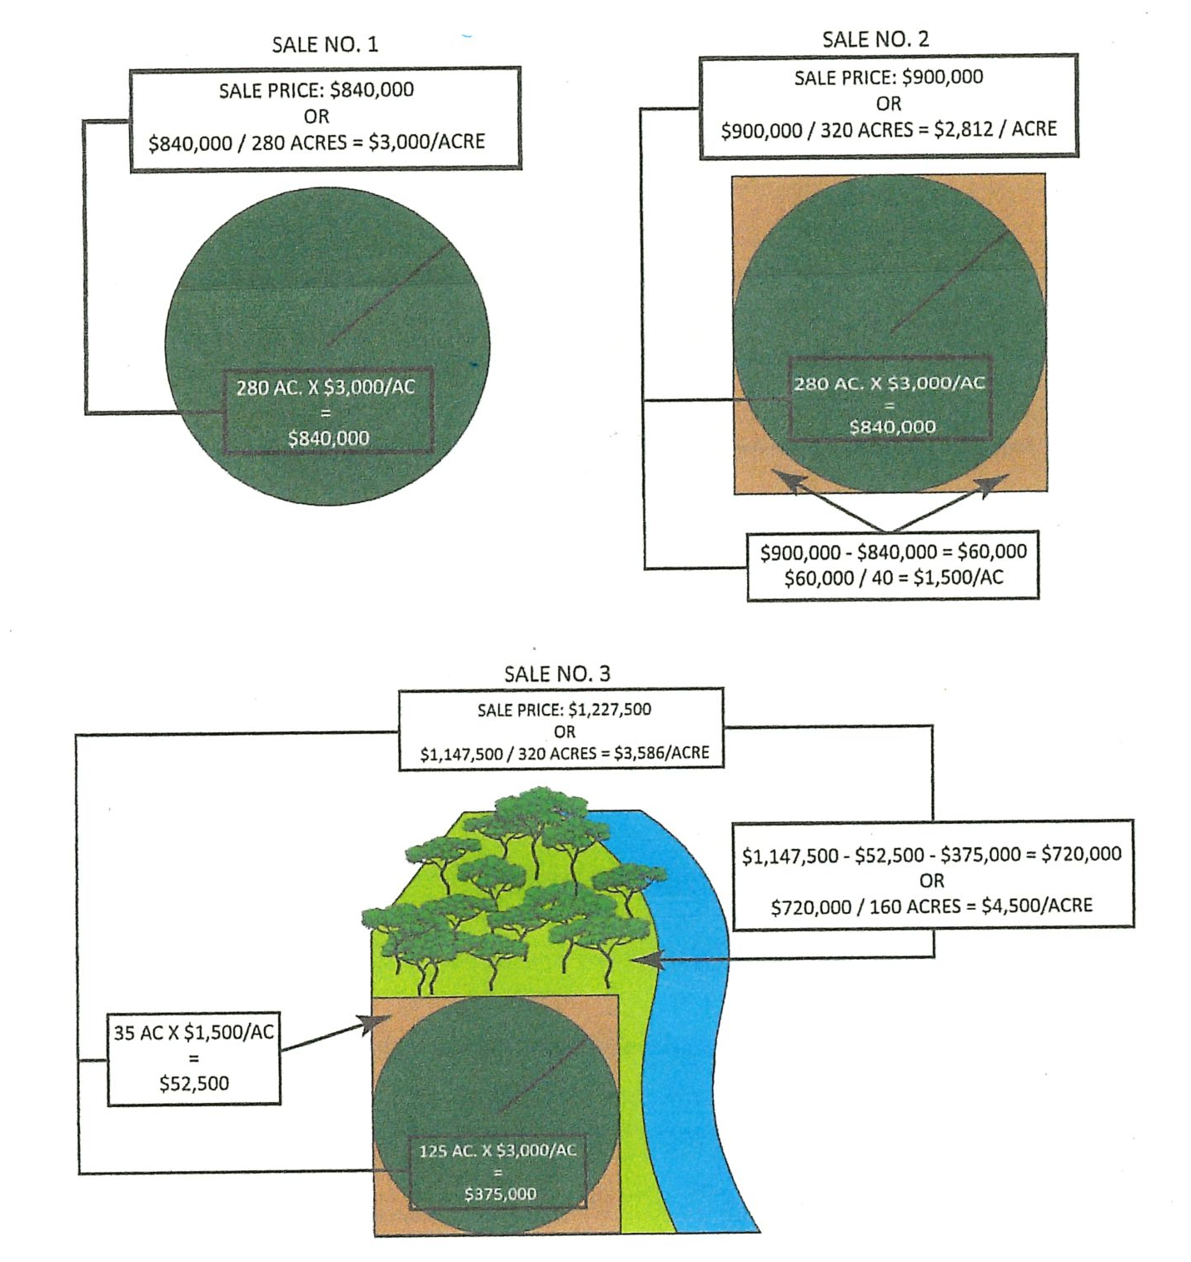
Consider these (3) Three Sales:
Allocation Among Land Types

Slide 18
Allocation Among Land Types
The drawing explains utilization of residual analysis or identifying price contribution. The first graphic depicts Sale 1, a circular tract of irrigated land containing 280 acres. The sale price was $840,000, which converts to $3,000 per acre.

Slide 19
Allocation Among Land Types
The second graphic, Sale 2, is a square tract of land containing 320 acres. The circular irrigation pivot still covers 280 acres, but the four dry corners contain 40 acres. These areas can be farmed, but the commodities are dependent upon natural rainfall, i.e., water availability is usually less and not controlled during the critical times during the growing season. Thus, corners are less valuable and the contribution of the corners becomes a “residual” where the known value of the irrigated land from Sale 1 is deducted from the overall sale price of Sale 2. That price residual is allocated to the dry corners, or converts to $1,500 per acre.

Slide 20
Allocation Among Land Types
The final graphic depicts irregular shaped Sale 3 with three land types. The tract is located along the river with aesthetic hardwood trees. A circular 125-acre portion is irrigated plus 35 acres are dryland farmed. The contribution rates found in Sale 1 and Sale 2 are applied to the irrigated and dry cropland acreages at $3,000 and $1,500 per acre, respectively. That total is then deducted from the total price of Sale 3, allowing the residual of $4,500 per acre to flow to the non-crop areas.

Slide 21
This illustrates the residual process. The price paid for irrigated land in Sale 1 was applied to the irrigated land in Sale 2; the remaining price or residual represents the contribution for Type 3 (dry cropland) at $1,500 per acre. Mathematically for Sale 2, ($900,000 price – (280 irrigated acres x $3,000/acre [from Sale 1])) = $60,000, producing $1,500 per acre residual for 40 acres of dry cropland.
Tabular Allocation Amongst Land Types
 | Sale Price | Size | Time | Access | Price/AC | Acres | $/Acre | Acres | $/Acre | Acres | $/Acre
Sale 1 | $840,000 | 280 | Current | Paved Hwy | $3,000 | 0 | $ - | 280 | $3,000 | 0 | $ -
Sale 2 | $900,000 | 320 | Current | Paved Hwy | $2,813 | 0 | $ - | 280 | $3,000 | 40 | $1,500
Sale 3 | $1,147,500 | 320 | Current | Paved Hwy | $3,586 | 160 | $4,500 | 125 | $3,000 | 35 | $1,500

Slide 22
 | Sale Price | Size | Time | Access | Price/AC | Acres | $/Acre | Acres | $/Acre | Acres | $/Acre
Sale 1 | $840,000 | 280 | Current | Paved Hwy | $3,000 | 0 | $ - | 280 | $3,000 | 0 | $ -
Sale 2 | $900,000 | 320 | Current | Paved Hwy | $2,813 | 0 | $ - | 280 | $3,000 | 40 | $1,500
Sale 3 | $1,147,500 | 320 | Current | Paved Hwy | $3,586 | 160 | $4,500 | 125 | $3,000 | 35 | $1,500
The same irrigated rate of $3,000 per acre and $1,500/acre for dry cropland is used for the residual or contribution for the timbered river area in Sale 3. Mathematically, ($1,147,500 – ((125 irrigated acres x $3,000) – (35 dry crop acres x $1,500/acre)) = $720,000 ÷ 160 acres), or $4,500/acre for the Type 1 recreational land.
The process summary of residual analysis begins with either the most valuable or predominant land type in a market.

Slide 23
But it can also be converted to a Ratio.
Type 1 (Recreational): | $4,500/Acre = 100%
Type 2 (Irrigated): | $3,000/Acre = 67% ($3,000 ÷ $4,500)
Type 3 (Dry Cropland): | $1,500/Acre = 33% ($1,500 ÷ $4,500)

Slide 24
Because markets present a smaller dataset with which to conduct analysis, identifying the relationship between land types allows for the allocation of sale price amongst those land types regardless of differences in physical features. While differences such as paved road frontage versus gravel county road frontage may have an impact to the overall price per acre, that impact is equally felt amongst all land types, and thus their price relationship remains the same in most cases.

Slide 25
To establish the price ratios, an appraiser must choose the land type upon which to base all ratios. For example, an appraiser may choose to consider the most expensive land in a market as the Type 1, or Class 1 land. All other land types are then assigned a ratio dependent upon their price relationship with the Type 1. Utilizing the data, the value relationships would be as follows:

Slide 26
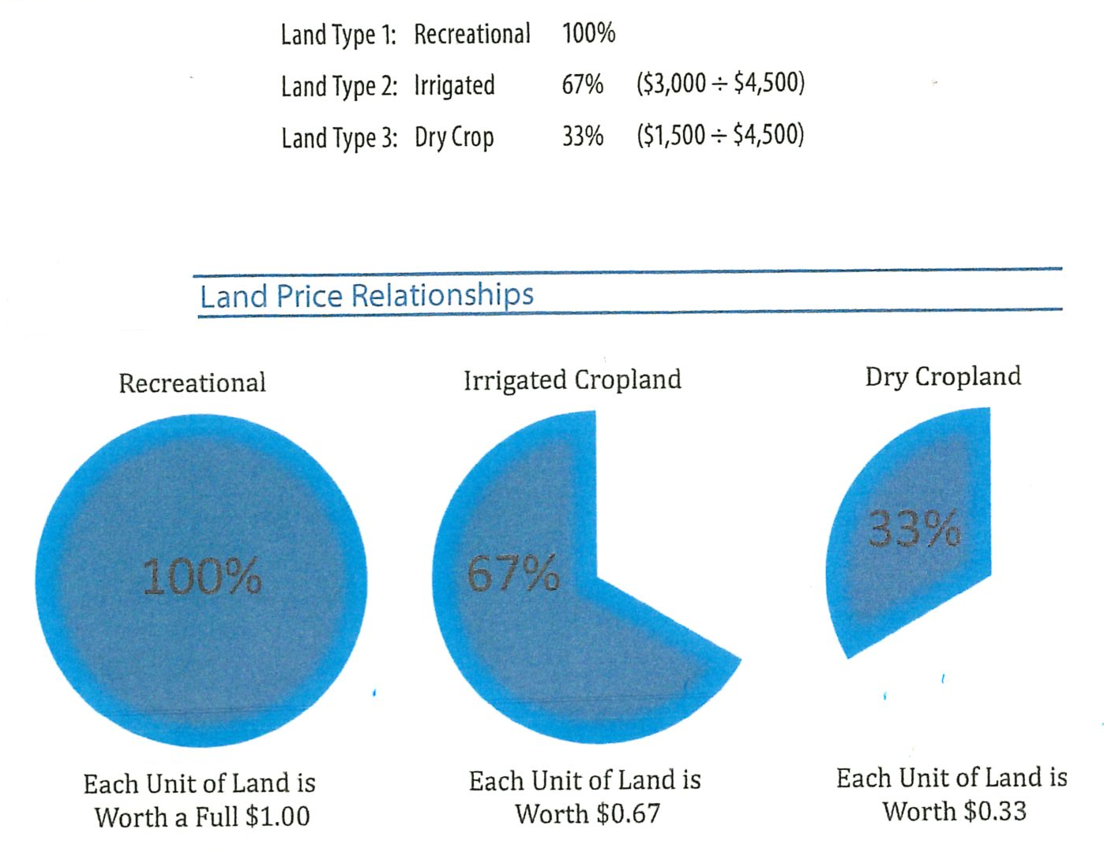
RESEARCH
DESIGN

Slide 27
APPLICATION OF PRICE RATIOS
Price ratios allow the appraiser to analyze sales containing various land type mixtures. In the following example, a property is composed of the same acreages for each of the three land types.
Land Type | Description | Acres |  | Value Ratio |  | Equivalency
Land Type 1 | Recreational | 100 | x | 100.00% | = | 100
Land Type 2 | Irrigated | 100 | x | 66.67% | = | 66.67
Land Type 3 | Dry Crop | 100 | x | 33.33% | = | 33.33
 |  |  |  |  |  | 200.00
Total Equivalency
Note the total of the subject property parcel is 300 acres.

Slide 28
Land Type | Description | Acres |  | Value Ratio |  | Equivalency
Land Type 1 | Recreational | 100 | x | 100.00% | = | 100
Land Type 2 | Irrigated | 100 | x | 66.67% | = | 66.67
Land Type 3 | Dry Crop | 100 | x | 33.33% | = | 33.33
 |  |  |  |  |  | 200.00
Total Equivalency
The property contains 300 acres equally dispersed with 100 acres each. Recreational land is utilized to establish the “base” and ratios. The ratios are applied to the acreages within each land type to convert the inferior land price to 100% equivalency. In this case, each are of:
Recreational land is worth a full acre, or 100%
Irrigated crop is worth 0.67 acres of 100% land, and
Dry crop is worth 0.33 acres of 100% land

Slide 29
Land Type | Description | Acres |  | Value Ratio |  | Equivalency
Land Type 1 | Recreational | 100 | x | 100.00% | = | 100
Land Type 2 | Irrigated | 100 | x | 66.67% | = | 66.67
Land Type 3 | Dry Crop | 100 | x | 33.33% | = | 33.33
 |  |  |  |  |  | 200.00
Total Equivalency
When added together, the total 100% “equivalency” is 200 acres. The property physically contains 300 acres, but, in terms of “value,” it is worth the same as 200 acres of the top land type (recreational land). Stated differently, the owner could trade the 300 acre property as configured for a 200 acre recreational property and be in the same value position.

Slide 30
The allocation process using ratios allows data to be standardized to the same base. This text refers to the standardized property size as its “equivalency” or “equivalent acres.” Equivalency simply refers to a property’s size expressed in terms of the land type utilized as the basis of ratio analysis.

Slide 31
If the alternative methodology were utilized for calculating value ratios, the equivalency would look like the following:
Land Type | Description | Acres |  | Value Ratio |  | Equivalency
Land Type 1 | Recreational | 100 | x | 150.00% | = | 150.00
Land Type 2 | Irrigated | 100 | x | 100.00% | = | 100.00
Land Type 3 | Dry Crop | 100 | x | 50.00% | = | 50.00
 |  |  |  |  |  | 300.00
Total Equivalency

Slide 32
Once you establish ratios you can use it to adjust sales. Assume a sale price of $600,000 for 300 acres. Using the calculated recreational equivalency of 200 acres equals:
$600,000/200 (recreational equivalency) = $3,000
RESEARCH
ABSTRACT
DESIGN

Slide 33
Then ratios can be used to allocate the rest of the sale:
Recreational Value = $3,000/acre
Irrigation Crop ($3,000 x 67%) = $2,000/acre
Dry Crop ($3,000 x 33%) = $1,500/acre
Using the irrigation crop as the base, the irrigation equivalency was found to be 300.
$600,000/300 (irrigation equivalency) = $2,000/acre
Recreational = ($2,000 x 150%) = $3,000/acre
Dry Crop = ($2,000 x 50%) = $1,000/acre
RESEARCH
ABSTRACT
DESIGN

Slide 34
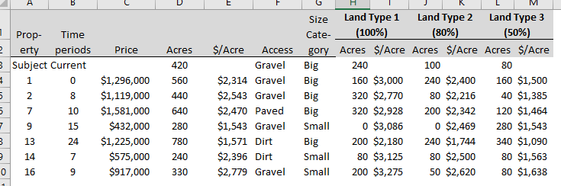
Analysis Example
Vacant Land Sales

Slide 35
The process of allocating each of the properties into their contribution components of Land Types included an analysis of price ratios between the various land types. Those relationships were concluded to be 100% for Land Type 1, 80% for Land Type 2, and 50% for Land Type 3. These ratios are utilized to allocate the overall sale price. Recall that the application of ratios follows the process of converting a property to its 100% equivalency, and dividing the result into the sale price. This yields the contribution rate for the Type 1 Land. Price ratios for each subsequent land type are then applied to the Type 1 rate and contributory values for each type are established. As an example, Sale 1 in Table can be seen as follows:

Slide 36
*Sale one is used* total Land 560 Acres
Sale
Type 1 Land 160 Acres x 100% = 160
Type 2 Land 240 Acres x 80% = 192
Type 3 Land 160 Acres x 50% = 80
Equivalency 432
Sale Price $1,296,000
÷Equivalency 432
=Type 1 Land $3,000
Type 1 Land $3,000 per acre
x 80% $2,400 per acre Type 2 Land
Type 1 Land $3,000 per acre
x 50% $1,500 per acre Type 3 Land

Slide 37
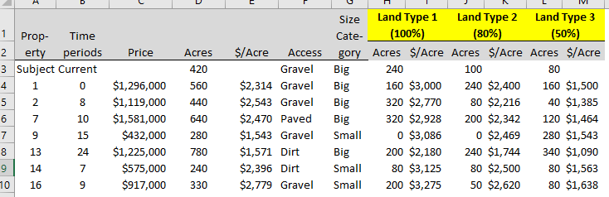
This process is the tool utilized to allocate total land price over the various units found within each market-recognized land type based upon different price contributions. It is utilized to allocate each of the remaining sales found in the listing of sales.
As shown not all allocated values across all sales are the same. This calls attention to various ratings provided in several categories that may create the difference seen.

Slide 38
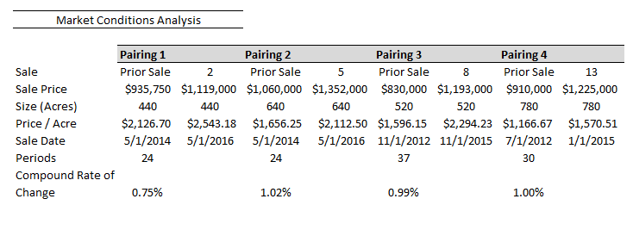
Based on these paired sales @ 1% compounded monthly was used.

Slide 39
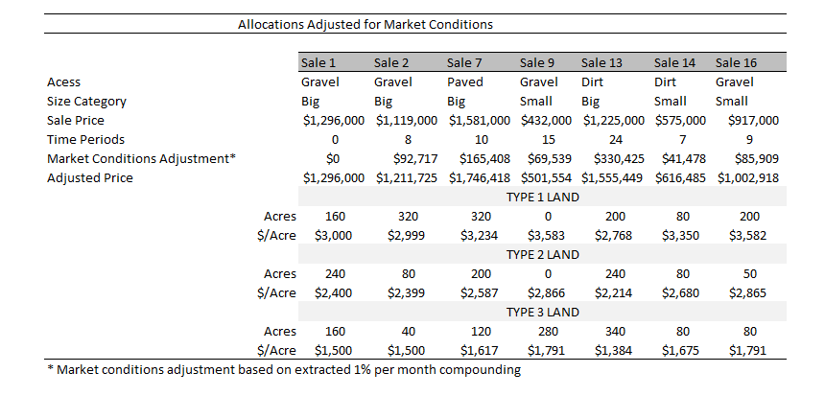

Slide 40
While all allocated values still are not identical, the dataset provides ample evidence of the contribution rates for properties with similar property-specific characteristics as the subject. Recall that the subject utilized in the example report is a 420-acre tract of land that falls in the “Big” size category and is located on a gravel road base. Sale 1 and Sale 2 are both tracts that are located on gravel roads and are rated in the “Big” size category. The allocated land values for the Type 1 land for the two sales is $3,000 and $2,999 respectively. Similar correlations are present in the Land Type 2 and Land Type 3 allocations for each sale. Each of the remaining sales is dissimilar to the subject tract in one or more property-specific categories found to have an impact on value.

Slide 41
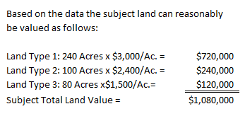

Slide 42
It is important to recognize that this example made only an adjustment for market conditions prior to allocating the sale prices to utilize in the valuation of the subject. Any other transactional adjustments that are needed within a dataset should be adjusted for prior to selection.
Transactional adjustments typically include:
Property Rights Conveyed
Financing
Conditions of Sale

Slide 43
For more information on this tool, I recommend taking courses with American Society of Farm Managers and Rural Appraisers.
They have devoted substantial use of these techniques in their courses and seminars.

